Slide 1
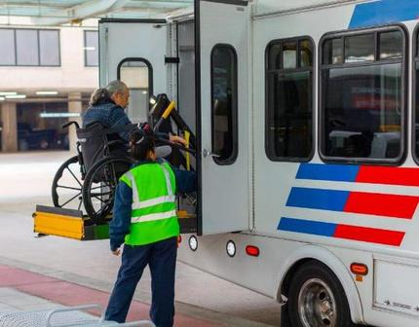
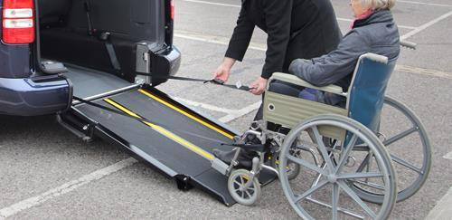
Passenger Assistance Safety & Sensitivity
(PASS) 8.0
Kansas Rural Transit Assistance Program
KS RTAP Instructor
Anne Lowder
alowder@ku.edu
Resources:
CTAA’s PASS 8.0 2025
Q’Straint Training 2019
Notes:
Welcome to Kansas RTAP Passenger Safety and Sensitivity

Slide 2







Housekeeping
FACILITY``
SCHEDULE
BATHROOMS
BREAKS
PHONES
MATERIALS

Slide 3
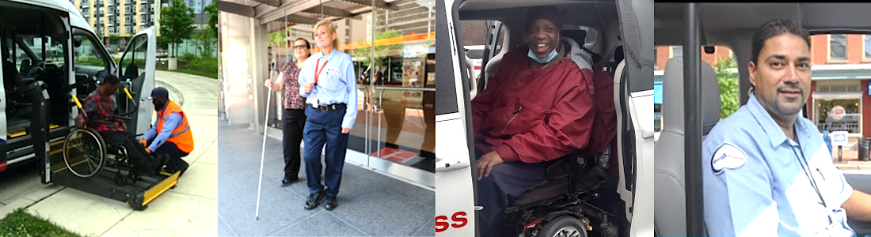
Program Contents
The KS RTAP Passenger Assistance Course Addresses:
Communicating With Your Passengers
Our Passengers are People First
Transporting an Aging Society
Americans With Disabilities Act (ADA)
Q’Straint Liability and Regulations
Q’Straint Securement Equipment and Maintenance
Q’Straint Securement Principals
Q’Straint Securing Difficult Chairs
Notes:
The objective of the KS RTAP Passenger Assistance course is to help you become familiar with and proficient at your role as a professional transportation provider, passenger assistance ,disability awareness, and wheelchair securement.

Slide 4
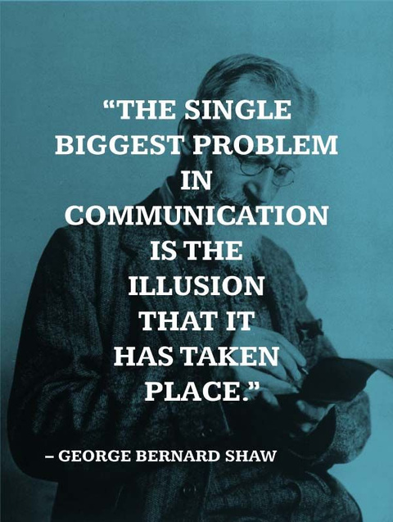
Communicating with Your Passengers
Notes:
Communication is an important tool for providing service to our passengers. By talking to your passenger about the type of assistance they need, then explaining what you are doing as you are doing it, makes your difficult job go more smoothly. We often make assumptions that when we are talking to someone communication is happening. It may not be.

Slide 5

Communicating With Your Passengers
Commonly-used Terms | Preferred Language
Able-bodied, Normal | Non-disabled or person without disability
Abnormal | Disabled person, person with a disability
Blind | Blind for someone who has complete loss of sight. Limited vision, low vision, visually impaired for someone who is neither legally or completely blind.
Mad, Psycho, Deranged, Retarded | People with mental illness
Differently-abled, Special, Gifted, Handicapped | Person with disability Disabled person
Wheelchair-bound | Person who uses a wheelchair, wheelchair user
Suffers from, Victim, Stricken with | They have/are living with …..
Use Person-First Language
Avoid Outdated and Offensive Terms
Be Aware of Individual Differences
Look at nonverbal communication signals as a group
Notes:
Advocates of person-first language believe that a person with disabilities is an individual first and shouldn’t be identified by their disability.
Examples include:
“People with disabilities” instead of “disabled people”
“A person who uses a wheelchair,” not a “wheelchair-bound person”
Be conscious of antiquated words that have negative connotations for people with disabilities (e.g., “handicapped” or “challenged”).
People from different countries and cultures tend to use different nonverbal communication gestures.
Consider all the nonverbal signals you receive, from eye contact to tone of voice to body language.

Slide 6

Communicating With Your Passengers

Slide 7
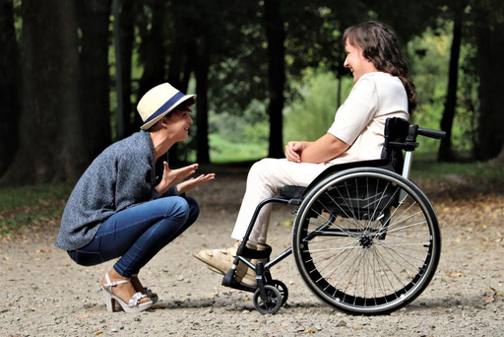

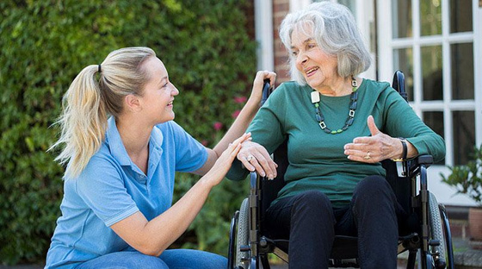
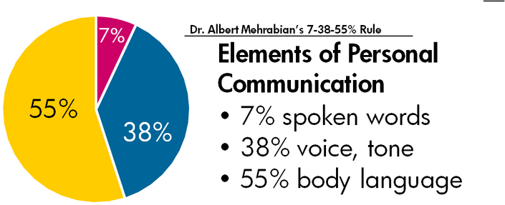
Communicating With Your Passengers
Make Eye Contact
Adjust the Way You Communicate
Check for Comprehension
Speak Directly to Your Passenger
Notes:
Communicating face-to-face and making eye contact during the conversation is critical in making the communication process successful.
Adjust how you communicate. If it appears that your passenger is having difficulty understanding you, change your words, change the volume, write down what you are trying to communicate, use pictures. You may have a passenger that does not understand English. Any changes in your communication must be done with respect and understanding. If you use words or a tone that may make the person, feel incompetent, you lose your opportunity to communicate.
Check for comprehension. If you are not sure that your passenger is understanding your message, ask them if they have any questions. Do not simply ask, “Do you understand?” People who are confused or who do not want to create a stir will often agree, whether they understand or not. Do not pretend that you do.
Speak to your passenger. Speaking to the other person may make your passenger feel as though you do not think he or she is capable of understanding you. You may have an overbearing family member that just dominates the conversation. It’s possible that overbearing family member is afraid to let “mom” talk because she may slip and tell you that she is being abused by that family member. We do not want to assume that abuse IS happening in that situation, but we also do not want to miss the opportunity to help someone that may be abused.

Slide 8
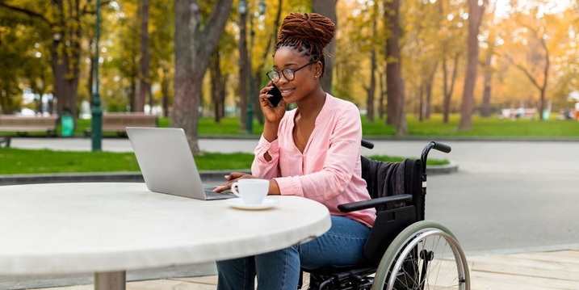

Our Passengers are People First
See The Person, Not The Disability
8
Notes:
Of all the things you do as a driver, the way you interact with your passengers will have the most influence on your job
Our passengers come in different sizes, shapes, and ages. Some of our passengers have a disability, some do not. Becoming familiar with some of the things you may experience with your passengers will greatly help you provide safe and professional service. After all, they are people first.

Slide 9

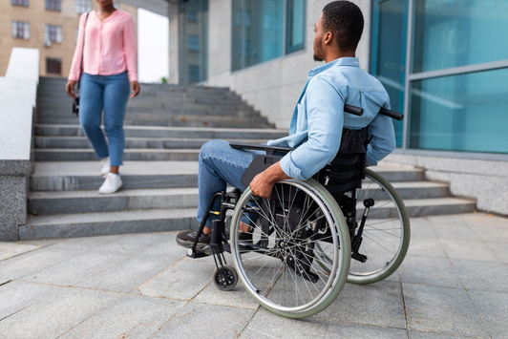
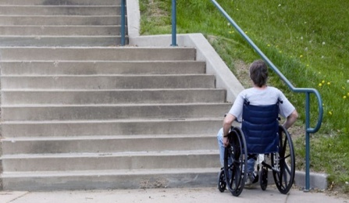
Our Passengers are People First
What is a handicap?
Handicap: A barrier that prevents individuals with a disability from enjoying the same opportunities that are available to persons without disabilities.
Handicap can also be used when describing a situation such as ”the stairs are a handicap for someone who cannot climb stairs.”
This term DOES NOT describe a person with a disability.
Notes:
Let’s start this section of the course with a little clarification. There are two words that are used interchangeably when referring to people with disabilities. Those words are “disabled” and “handicapped”. We use these words as if they mean the same thing. You may even be thinking to yourself, “Aren’t they the same.”? No, they are not. Those steps are a handicap. They are preventing that person in a wheelchair from entering the building or getting to something on a different level. A “handicap” is a barrier imposed by society, the environment, or oneself. Do we really need to say, “Handicapped Child At Play”? This example is a traffic sign. Are you going to drive differently if it just says, “Child At Play”? A “handicap” is not a disability!

Slide 10
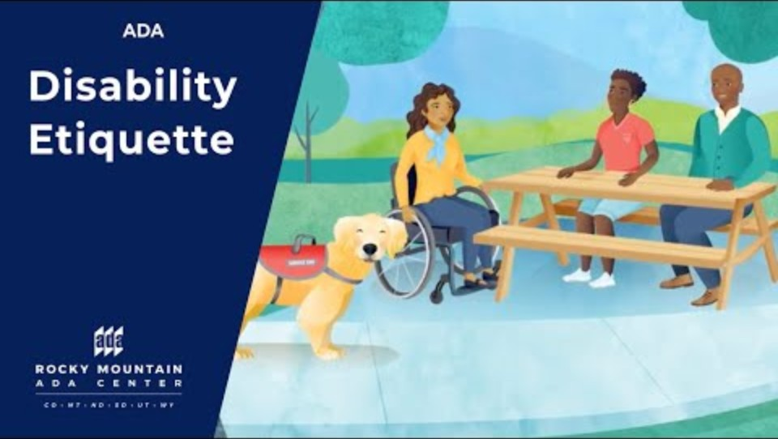
Our Passengers are People First
Disability Etiquette – Respectful Ways to Interact with People with Disabilities
Disability Etiquette - Respectful Ways To Interact with People With Disabilities

Slide 11
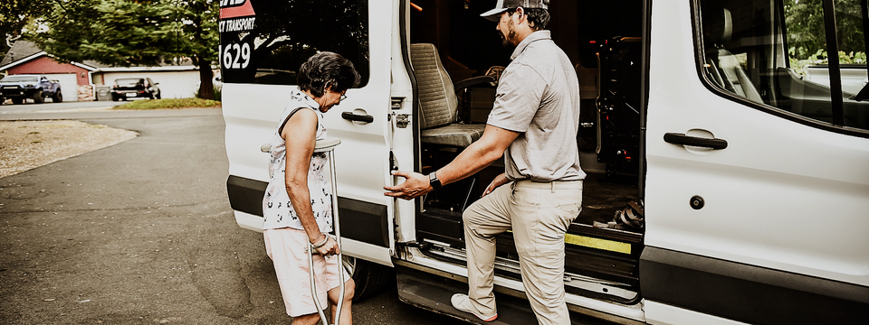
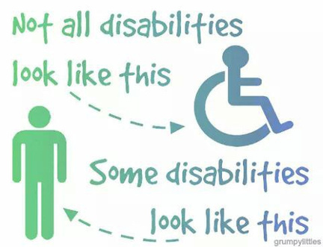
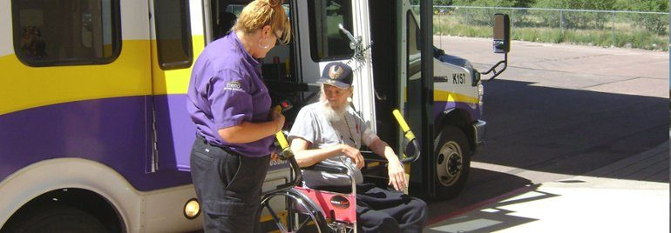
Our Passengers are People First
Recognize the person first, NOT their disability.
Your goal as a transportation provider is to provide all our passengers with the same safe and courteous service.
Person First Language
People with disabilities have human needs, not special needs.
Notes:
First, greet the passenger, then ask how they would like to be assisted.
After you learn how to best assist, follow the passenger’s instructions.
Emphasizes the person, not the disability, by placing the person first
Recognizes that the disability is not the primary, defining characteristic of an individual
Is only one of several aspects of the whole person
While “special needs” is often used with good intentions, it’s vague, outdated and over time has become offensive to many.

Slide 12
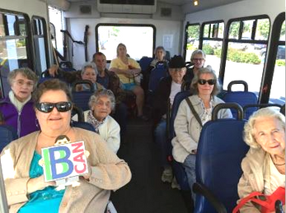
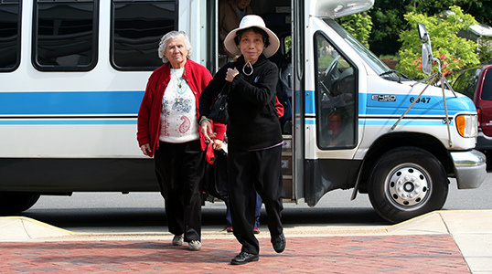
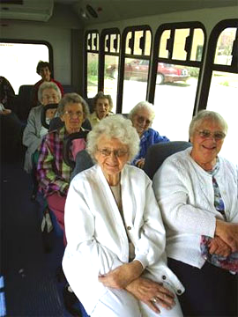
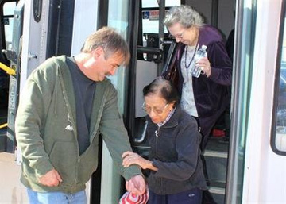
Transporting an Aging Society

Slide 13
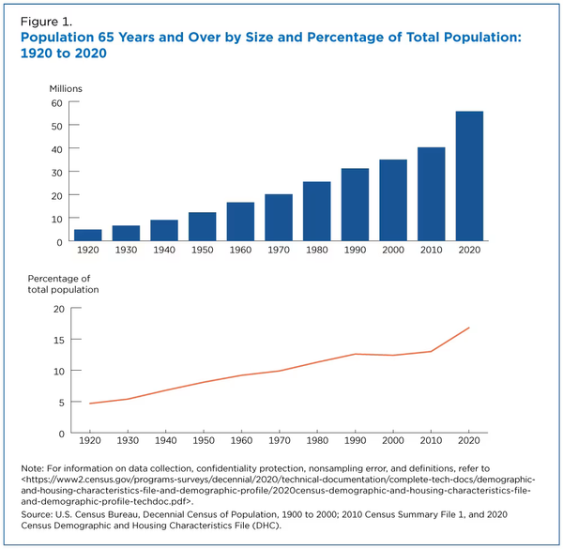
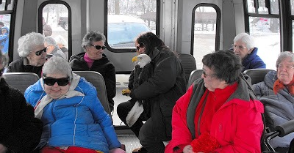
Transporting an Aging Society
Older Population Growth Facts
In 2020, the 65-74 age largest older age group:
33.1 million people, representing over half of the 65-and-over population
Represented 1 in 10 Americans
Experienced the largest growth of any older age group the previous decade
Unintentional Injuries
CDC states Unintentional injuries is the 8th leading cause of death – adults 65+
Falls and motor vehicle crashes account for 70% of those deaths.
37 million falls occur with older adults 65+
Notes:
According to the 2020 Census, the U.S. population age 65 and older grew nearly five times faster than the total population over the 100 years from 1920 to 2020.
In 2020, the older population reached 55.8 million or 16.8% of the population of the United States.

Slide 14
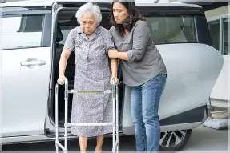
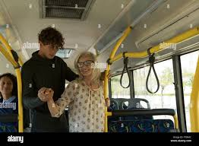
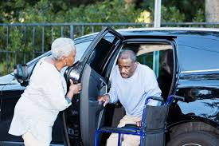
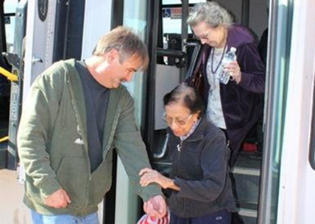
Transporting an Aging Society
Fall Hazards Directly Related to Transit
Steps can be challenging
Frequent or sudden stops or starts can be difficult.
Slippery surfaces due to weather.
Personal items in the aisle.
Crowded vehicle.
Dark interiors are hazardous.
Wheelchair Retractors Left in the track and not put up after each use.
Notes:
Steps can be challenging for people with balance issues, poor vision, or a fear of falling. Steps become problematic if they are too high, lack handrails, or have unmarked edges.
Frequent or sudden stops or starts can be difficult. A sudden lurch in the vehicle can cause a person to lose footing.
Slippery surfaces due to weather. A wet or icy surface may reduce grip between the shoe and the ground increasing the likelihood of a fall.
Personal items in the aisle. Items in the aisle can become tripping hazards for the passengers and the driver.
Crowded vehicle. On larger vehicles that carry more passengers, there may not be an available seat or grab rail to reduce the risk of falling.
Dark interiors are hazardous. Inadequate lighting makes it difficult to see and avoid tripping hazards.
Wheelchair Retractors Left in the track and not put up after each use. Create tripping hazards for those boarding using the lift.

Slide 15
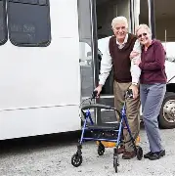
Transporting an Aging Society
There are times when transporting seniors becomes much like a personal service:
Drivers may see the same person regularly.
For someone who lives alone, a long ride may be considered a social event.
Seniors may depend more heavily on their driver than other passengers for conversation and independence.
According to USAging, nearly 600,000 older adults stop driving each year.
Giving up their car keys greatly limits their access to medical care, shopping, and opportunities for socialization.

Slide 16
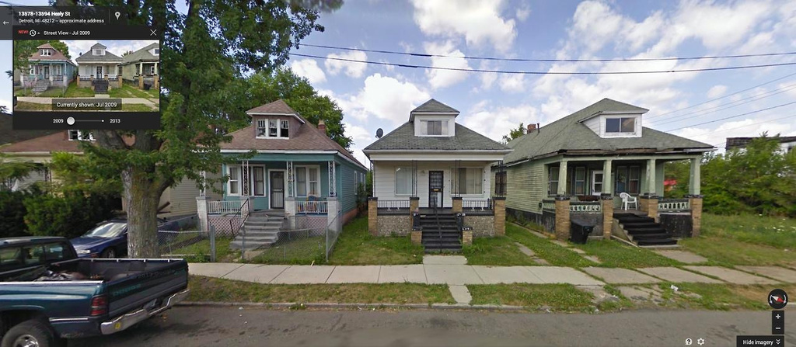
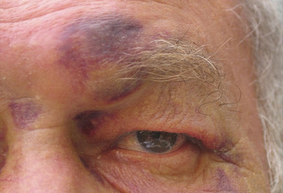
Transporting an Aging Society
Signs That a Senior May Be in Distress
Drivers often see people at their homes, in their neighborhoods and notice patterns:
How they keep their yard
The condition of their home
A porch light on or off during the day
Below are some signs that your passenger may be distressed.
Changes in mood
Greater irritability
Anxiety
Sadness
Indifference
Unusual elation or overactivity
Difficulties with short-term memory
Difficulty concentrating
Dressing inappropriately for existing weather conditions
Unusual patterns of judgement
Withdrawal & isolation
Less attention to personal hygiene, grooming & self-care
Weight gain or loss
Low energy & fatigue
Notes:
You see your passengers regularly. Maybe more than most people in their lives. You may notice changes in the appearance, behavior, interaction with you and other passengers, which may mean they are experiencing a health issue, or something worse.
Any unusual changes in behavior or appearance may be a sign that your passenger is experiencing some form of stress that may be detrimental to their health. These are some examples of what you may witness.

Slide 17
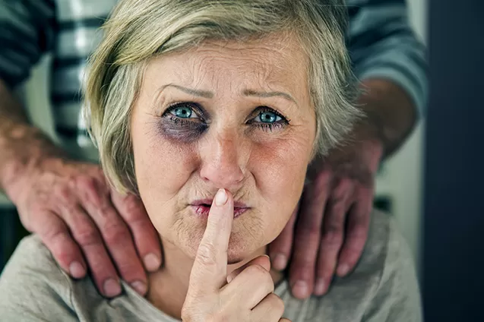
Transporting an Aging Society
What is Elder Abuse?
Recognizing Elder Abuse
Physical abuse includes inflicting physical pain or injury upon an older adult.
Sexual abuse includes touching, fondling, intercourse, or any other sexual activity with an older adult, when the older adult is unable to understand, unwilling to consent, threatened or physically forced.
Emotional abuse includes verbal assaults, threats of abuse, harassment or intimidation.
Confinement includes restraining or isolating an older adult, other than for medical reasons.
If you think someone may be a victim of elder abuse:
CALL 911 if they are in immediate danger.
Contact your local Adult Protective Services (APS) office.
Visit https://www.napsa-now.org/help-in-your-area to find one in your area.
Notes:
Elder abuse is a silent problem that robs seniors of their dignity, security, and—in some cases—costs them their lives. Perpetrators include children, other family members, and spouses, as well as staff at nursing homes, assisted living and other facilities. In almost 60% of elder abuse and neglect incidents, the perpetrator is a family member.
Steps you can take to respond if you notice a senior in distress.
DO NOT REMAIN SILENT.
Do not think others will notice or take care of the problem.
Speak with a supervisor about your concerns.
If you believe someone is in immediate danger, CALL 911.
What you are witnessing may be more than a senior in distress.
You may be witnessing elder abuse.
As many as 5 million older Americans are abused each year.
Annual loss of victims of financial abuse is estimated to be between $2.6 and $36.5 billion.

Slide 18
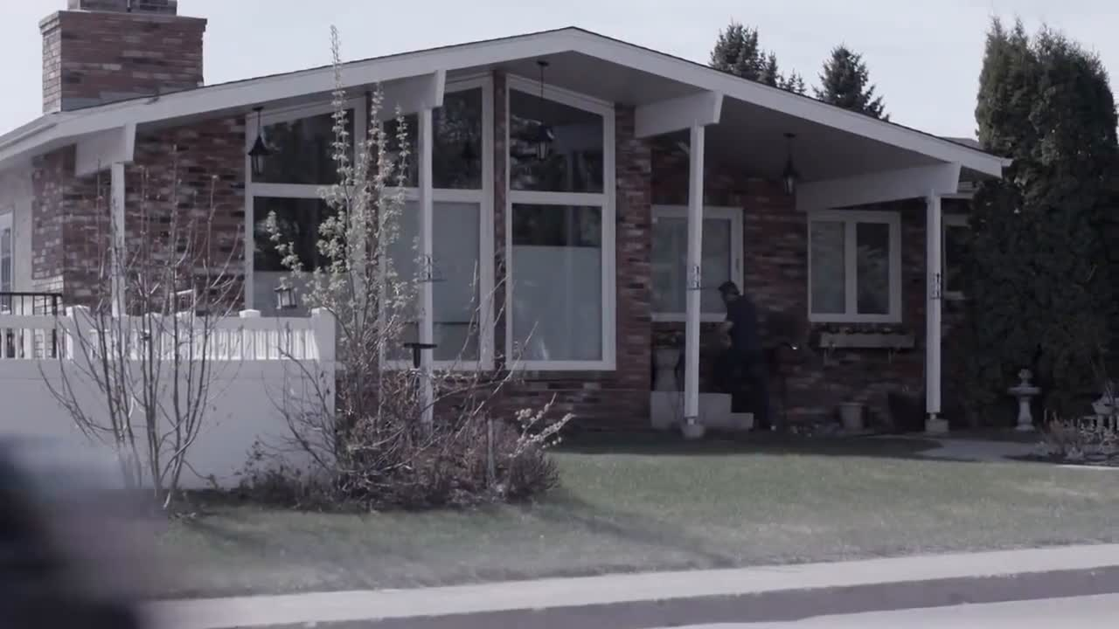
Transporting an Aging Society
Elder Abuse

Slide 19
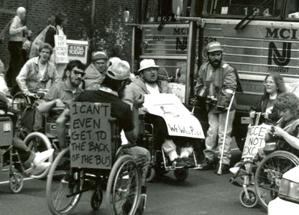
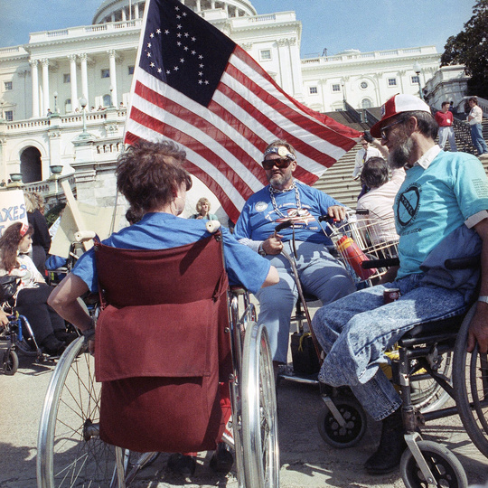
Americans With Disabilities Act (ADA)
Notes:
Do we discriminate against people with disabilities? How? Ask for examples. How may this be different than other forms of discrimination – such as racism, sexism, anti-Semitism? How is it the same?

Slide 20
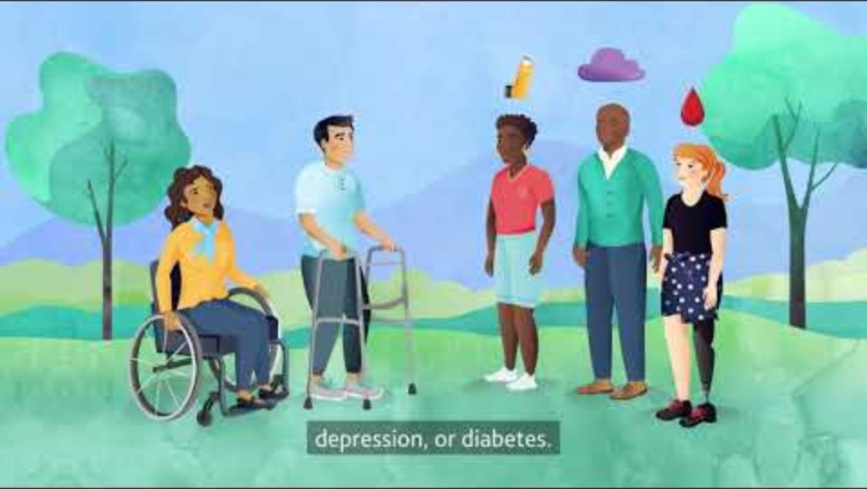
The Americans with Disabilities Act (ADA) protects people with disabilities from discrimination.
Disability rights are civil rights. From voting to parking to public transportation, the ADA is a law that protects people with disabilities in many areas of public life and prohibits discrimination in everyday activities.
ADA governs access. It is not a safety law.
The United States Department of Transportation (USDOT) and Federal Transit Administration (FTA) regulations that impact public transportation are:
49 CFR, Parts 27, 37, 38, and 39
ADA Circular (FTA 4710.1)
The Americans With Disabilities Act (ADA)
The Americans with Disabilities Act (ADA) was signed into law on July 26, 1990, by President George H.W. Bush.
What is the ADA? Basics and Definitions of the Americans with Disabilities Act
For details, visit transit.dot.gov/ADA
Notes:
Physical or Mental Impairment
Any physiological disorder or condition, cosmetic disfigurement, or anatomical loss affecting one or more body systems, such as: neurological, musculoskeletal, special sense organs, respiratory (including speech organs), cardiovascular, reproductive, digestive, genitourinary, immune, circulatory, hemic, lymphatic, skin, and endocrine or
Any mental or psychological disorder such as intellectual disability, organic brain syndrome, emotional or mental illness, and specific learning disability

Slide 21
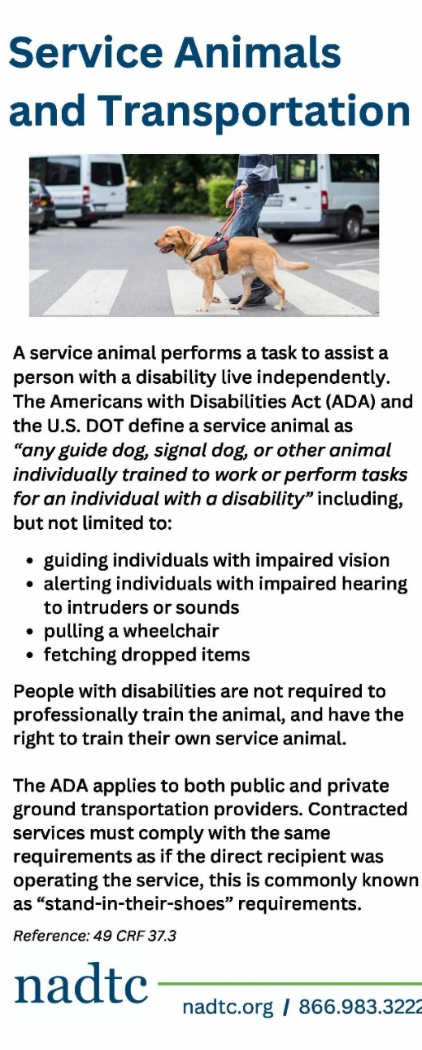
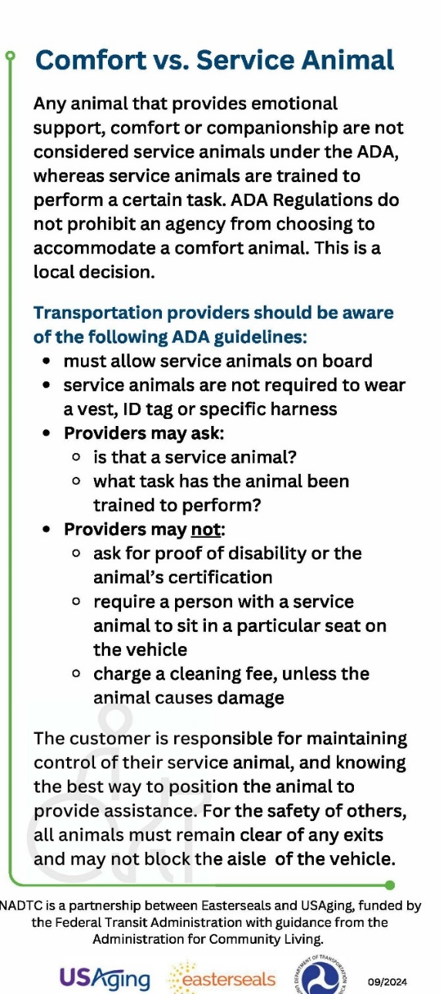
The Americans With Disabilities Act (ADA)
Bus drivers are required to assist persons with disabilities and treat individuals with disabilities in a respectful and courteous way
Can require wheelchairs be secured.
Cannot deny because the device cannot be secured.
Cannot require the person in a wheelchair to wear a lap and shoulder belt if other passengers are not required too
Must allow oxygen
Must allow service animals
Allow adequate time for boarding the vehicle
Permit passengers without wheelchairs to use the lift
Operate the lift at all stops when needed
Allow riding the lift in either the forward or backward position.
Assist passengers with lift and securement.
Announce all transfers, intersections, and destinations.
Walkers are not wheelchairs.

Slide 22
The Americans With Disabilities Act (ADA)
Non-discrimination means a transportation provider shall not:
Discriminate against an individual with a disability in connection with the provision of transportation services.
Based on the disability, deny any individual the opportunity to use the transportation service for the general public, if the individual is capable of using that service.
Require an individual with a disability to use designated priority seats, if they choose not to use those seats.
Impose special charges on people with disabilities, including individuals who use wheelchairs.
Require an individual with a disability to be accompanied by an attendant.
Refuse to provide transportation services to an individual with a disability solely because their disability results in appearance or involuntary behavior that may offend, annoy, or inconvenience employees or passengers.
It is NOT DISCRIMINATION to refuse to provide transportation services to an individual with a disability if that individual engages in behavior that is:
Violent
Seriously disruptive
Directly threatens the safety of others
Notes:
Specifically, under section 37.5, Nondiscrimination, the ADA addresses what it means by non-discrimination. BULLENT POINTS ON SCREEN
No entity shall not discriminate against an individual with a disability in connection with the provision of transportation service
An entity shall not, on the basis of disability, deny to any individual with a disability the opportunity to use the entity's transportation service for the general public, if the individual is capable of using that service
An entity shall not require an individual with a disability to use designated priority seats, if the individual does not choose to use these seats
An entity shall not impose special charges on individuals with disabilities, including individuals who use wheelchairs, for providing services required by the ADA or otherwise necessary to accommodate them
An entity shall not require that an individual with disabilities be accompanied by an attendant

Slide 23
Any Questions?

