Slide 1
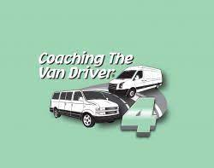
Resources
Coaching The Van Driver 4 Coaching Systems
CTAA PASS 7.0
Kansas RTAP Defensive Driving and Distracted Driving
Anne Lowder
KS RTAP
alowder@ku.edu
Notes:
Welcome to the first session of Coaching the Van Driver 4. The intent of this course is to refine and build on your skills as an experienced driver.
Since this is not a lecture course, your input and participation are essential .

Slide 2
Coaching the Van Driver 4
Session 1 Before You Start
Session 2 Essentials of Safe Driving
Session 3 Driving Environments
Session 4 Special Considerations Part One
Session 5 Special Considerations Part Two
Session 6 Distracted Driving
Notes:
These are the areas that we will be covering. Before your start is your pre trip.
Essentials for Safe Driving is the crux of this programs Defensive Driving tools utilizing SCC. Scanning, Cushion of Safety and Communicating.
The other three topics will cover driving scenarios to utilize SCC tools.

Slide 3
National Highway Traffic Safety Administration
Why Defensive Driving?
2021 | 2021 | 2020
Killed | 42,939 Thousand | Up 3,932
Injured | 2.49 Million | Up 215, 448
Overview of Motor Vehicle Traffic Crashes in 2021 (dot.gov)

Slide 4
KDOT Quick Facts

Slide 5
Centers For Disease Control

Slide 6
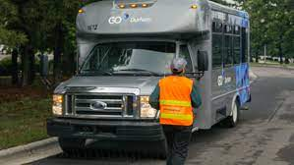
Before You Start
Session One
Self Appraisal Pages 3 -6
Video Presentation
Page 7 in the Response Book

Slide 7
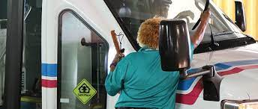
Before You Start
Session One
Who conducts the pre-trip at your agency?
List items that should be checked during a pre-trip?
  Inside the Van
  Secure loose items
  Check the dash indicators
  Check the Horn
  Check the fuel level
  Passenger area is clean
  Back up camera
  Seat adjustment
  Mirror adjustment
  Safety Belts
  Wheelchair securement
What else should you do before beginning a trip besides the pre-trip?
Yourself – are you 100% ready
Reduce Distractions
Manifest and Routes
Wear your Safety Belt
Wear your Mask
  Outside the Van
  Looking underneath
  Overall condition
  Lights
  Directional Signals
  Windows and doors
  Windshield Wipers
  Cycle Lift

Slide 8
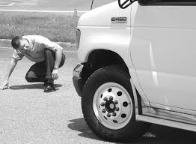
Before You Start
Session One
3. What is the recommended method for checking your van’s tire pressure and tread depth?
Tread depth gauge and Tire Pressure Gauge.
Proper Tread Depth?
4/32 of an inch.
Where to find the recommendations for proper tire pressure?
Vehicle Owners manual or side of the door.
4. Where is the spare tire located on the van you normally drive?

Slide 9
Before You Start
Session One
5. Properly adjusted mirrors will eliminate blind spots around your vehicle?
False
What techniques(s) can you use to further check blind spots?
Does the structure of the vehicle you normally drive create blind spots?
6. List the differences between the van you drive and your personal vehicle and how you can compensate for those differences.
Difference
Heavier
Longer wheelbase
Larger Size
Higher center of gravity
Larger Blind Spots
Other?
Compensation
Increase following distance
Turn with care – Greater turning radius
Scan sides/overhead. Susceptible to crosswinds.
Reduce speeds when turning/corners
Be aware of blind spots. Adjust mirrors. Scan.

Slide 10
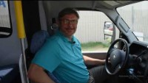
Adjusting Mirrors and Backing

Slide 11
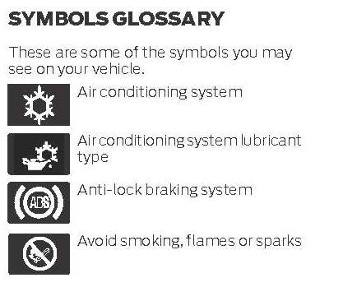
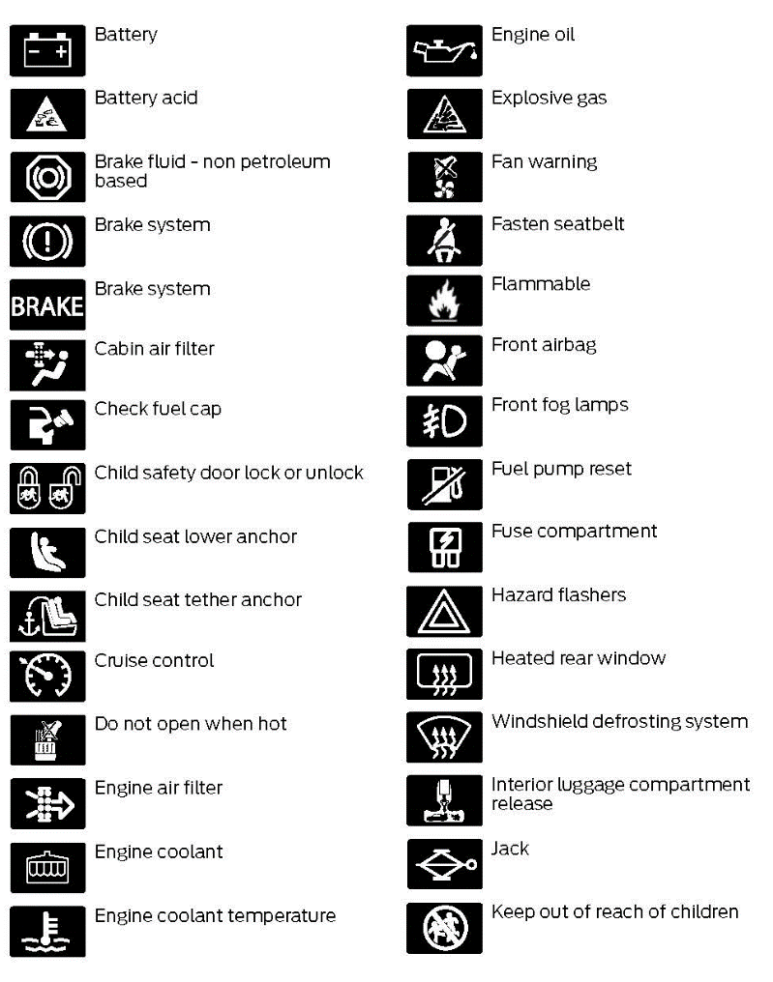
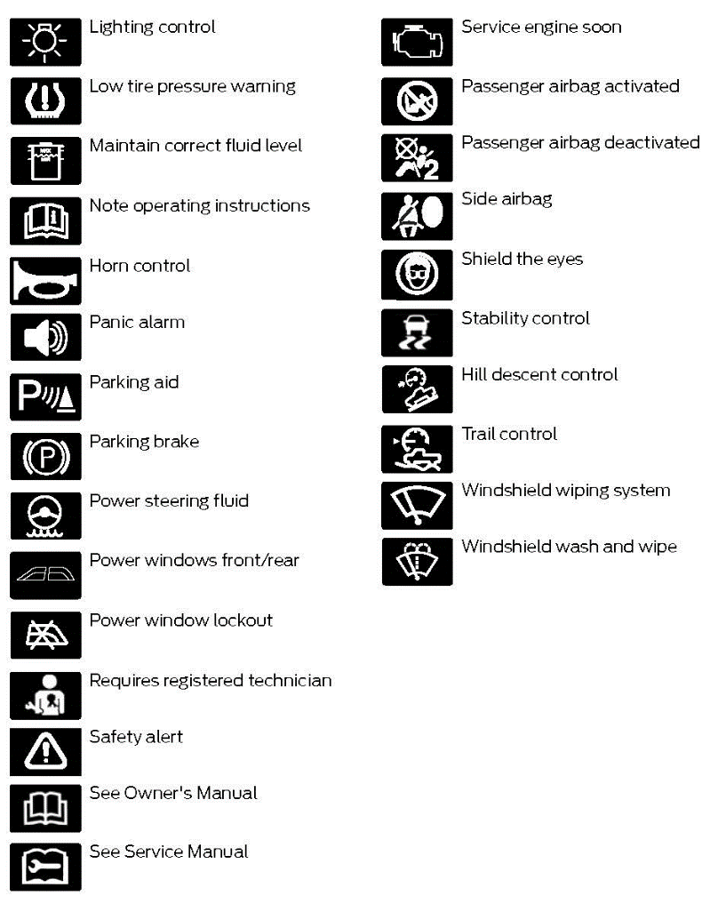
Before You Start
Session 1
7. Explain Dashboard Indicators?
Symbols for a Ford Transit 2021
Notes:
This is out of the Ford Transits 2021 owners manual. Just a lot of emojis to reference if they pop up on your dashboard.

Slide 12


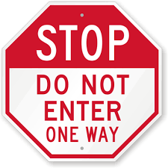
Before You Start
Session One
8. What road sign is red and has this shape?

Slide 13
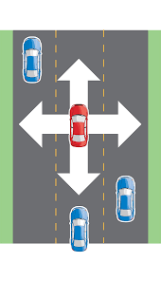
Session 2
Essentials of Safe Driving
Video
Page 9 in your response book
Notes:
In this session we will begin to look at what you can do while out on the road that can reduce your chances of being involved in a collision. We’ll start with some essential concepts – Scanning, Cushion of Safety and Communicating – and then see how these can be applied in your everyday driving.

Slide 14
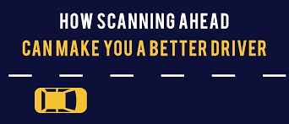
Session 2
Essentials of Safe Driving
Scanning
Scanning means looking down the road, to the sides and all around your vehicle. This goes beyond looking only in the direction of travel.
Cushion of Safety
Cushion of safety refers to the area immediately around your vehicle that you should try to keep free of other vehicles and pedestrians and fixed objects.
Communicating
Communicating means making yourself and your intentions known to other vehicles and pedestrians.

Slide 15
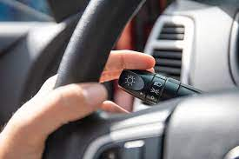
Session 2
Essentials of Safe Driving
9. How far down the road should you scan when traveling on open, highway-like roadways?
12 to 15 seconds or about a ¼ of a mile
10. How far down the road should you scan when driving in congested, city-like environments?
Block to a block and one half ahead
11. What are some ways in which you can miscommunicate with other drivers and pedestrians?
Signaling turns or lane changes too early or too late
Relying on eye contact alone
Swinging left before turning right
Not entering the deceleration or turn lane early

Slide 16
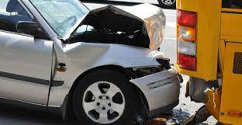
Session 2
Essentials of Safe Driving
12. How can you check your following distance?
Pick out a stationary object. When the back of the vehicle ahead passes by, begin counting: One-thousand-and-one to One thousand-and-four. If you can reach the overpass before counting to “four”, your following distance is at least four seconds.
What is the recommended minimum following distance?
At least a four second following distance is recommended in IDEAL conditions.
When would you increase your following distance?
Whenever conditions are not ideal:
Adverse weather
Loose road surfaces
When traveling downhill
Poor visibility conditions
Congested traffic
Tailgater
Heavy load of cargo or passengers

Slide 17
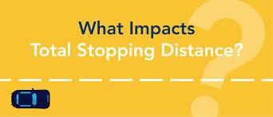
Session 2
Essentials of Safe Driving
13. How do each of the following terms affect your van’s total stopping distance?
Perception Distance
The distance your vehicle travels from the time you spot a hazard to the time you decide to act.
Reaction Distance
The distance your vehicle travels as you move your foot from the accelerator to the brake pedal and begin braking.
Braking Distance
The distance your vehicle travels after the brakes begin to take hold, until your vehicle comes to a complete stop.

Slide 18
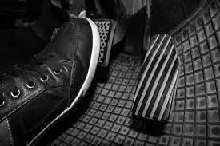
Session 2
Essentials of Safe Driving
14. How can covering the brake help you avoid panic stops and collisions?
Reduces your reaction time
15. How can leaning in your seat while checking your mirrors help maintain a cushion of safety?
Your site angle will change, letting you see more of your blind spots.
Helps you to monitor traffic
Helps you spot vehicles before they enter your blind spots.

Slide 19

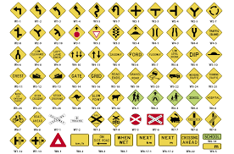
Session 2
Essentials of Safe Driving
What does a yellow sign with this shape indicate?

Slide 20
Session 2
Essentials of Safe Driving
16. It had just started to rain and I, “A”, was following vehicle “B” by about four seconds, just as I had learned in a driver safety course, when “B” suddenly jammed on the brakes. Unfortunately, I wasn’t able to stop in time and hit the back of his vehicle. My van had to be towed away.”
What happened in this situation? What, if anything could “A” have done to avoid this collision?

Slide 21
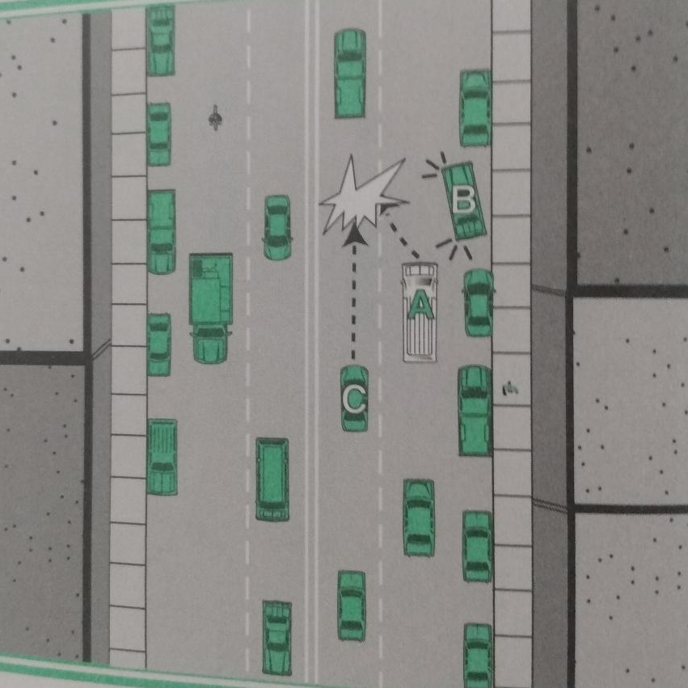
Session 2
Essentials of Safe Driving
17. In this situation, “A” was traveling in the right lane along a line of parked cars. When vehicle “B” pulled out, “A” was forced to swerve to the left so he wouldn’t run into “B”. As a result, “A” ran into vehicle “C” to his left. The driver of “A” said he couldn’t do anything to avoid this collision.
Do you agree with “A”? What could “A” have done to avoid this collision?

Slide 22
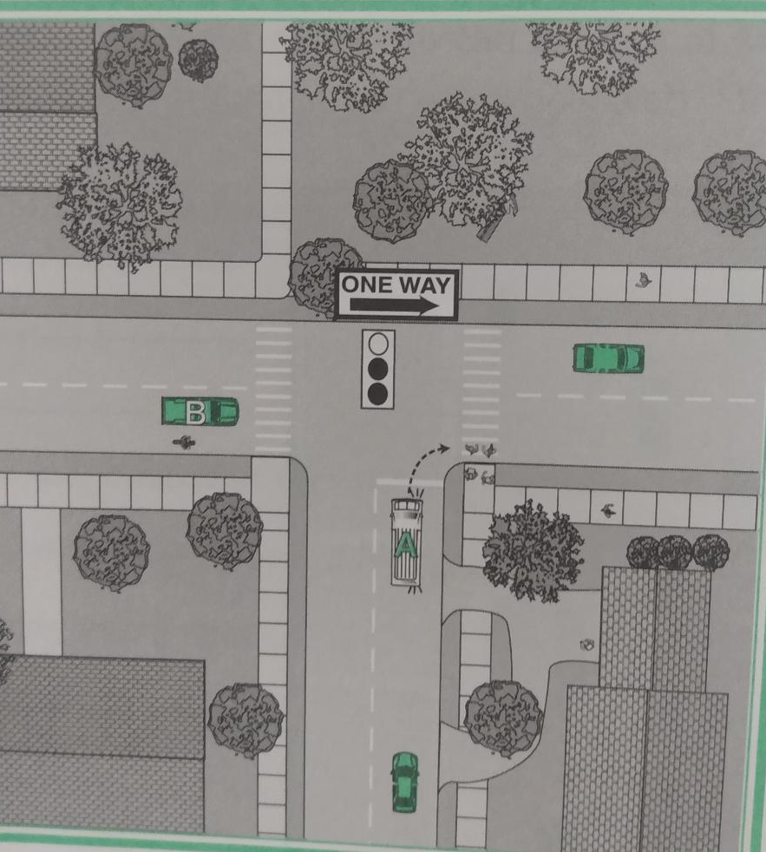
Session 2
Essentials of Safe Driving
18. In this situation, “A” was planning to turn right-on-red. “A” waited for “B” to clear the intersection before proceeding. Since it was a one-way street, “A” looked left for other vehicles and then started to turn. When he did, “A” almost collided with some pedestrians that had just started to cross the street.
How should “A” have handled this situation?

Slide 23
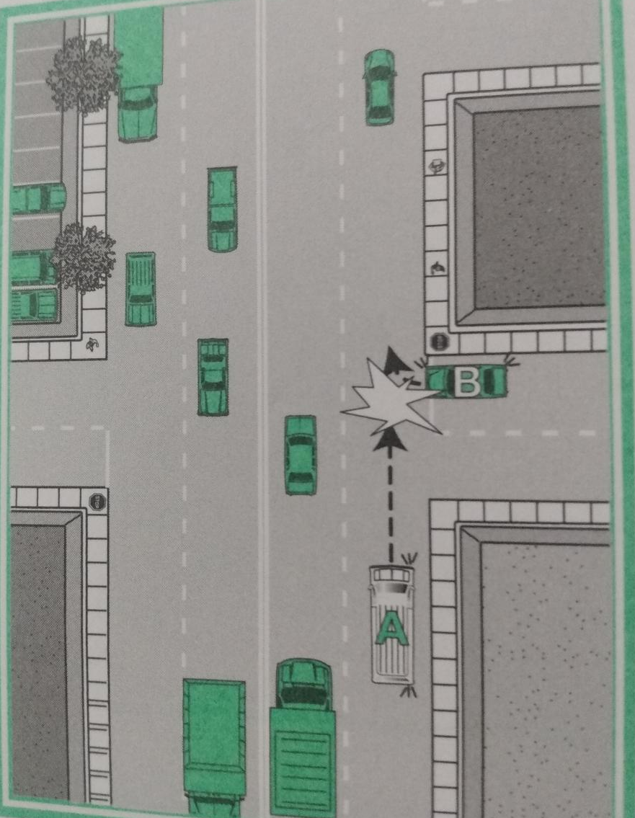
Session 2
Essentials of Safe Driving
19. “I (A) was driving in a commercial area with a number of store fronts on my right. I made sure to signal well before my turn and slowed ahead of time. As I approached, I saw another driver (B) waiting to pull out. I made eye contact, but when I got closer, he pulled out right in front of me and we collided! I thought he saw me. I guess he didn’t understand that I was going to make my turn at the next entrance. There really wasn’t anything I could have done to prevent this collision.”
What do you think of “A’s” statement? How would you have handled this situation?

Slide 24
Session 2
Essentials of Safe Driving
Coaching Reminder Points
E
Properly adjusted mirrors will ______?
A four second following distance is ________?
You should check your mirrors every _______?
The average reaction time for all drivers is _______?
Establishing eye contact is ________?
B
D
C
A

Slide 25
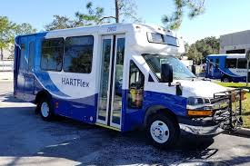
Driving Environments
Session 3
Video
Page 16 in your response books
Notes:
In this next session we’ll continue to look at how the principles of SCC can help you drive more safely and reduce the chances of being involved in a collision.
Let’s watch “Driving Environments”

Slide 26
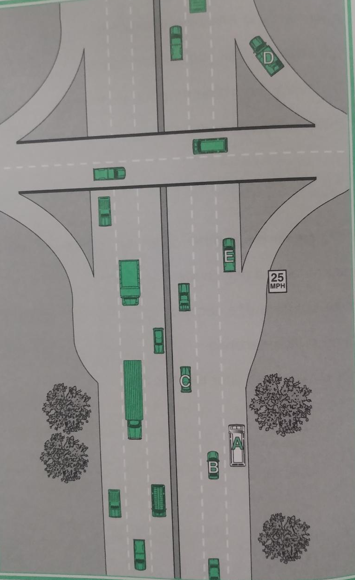
Driving Environments
Session 3
20. The van ”A” is approaching this highway interchange. Take a moment to consider the potential hazards “A” faces and what safety considerations the driver should keep in mind.
If you were the driver of van “A”, how would you proceed if you were not exiting at this interchange?
Assume vehicle “B” is not in its present location. Do you think “A” should change lanes before this point to avoid merging vehicles such as “D”?
How would you proceed if you were going to exit the highway at this interchange?

Slide 27
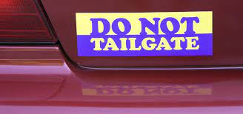
Driving Environments
Session 3
21. How can you know if you are being tailgated?
Check your mirrors every 3 – 5 seconds so you can spot people moving into a tailgating position.
What should you do once you know you are being tailgated?
Cover your brake
Increase your following distance
Doing both will give both you and the tailgating vehicle more time to stop should the need arise.
22. How far ahead of a turn or lane change should you use your directional signals?
At least 100 feet.
What factors should you consider when signaling?
In congested areas with multiple side roads, signaling 100 feet before a turn may not be clear. Be prepared by covering your brake as you approach.
There are times it is recommend that you signal early. For example, at highway speeds, signaling 100 feet before the deceleration lane does not give others much time to realize your intention.

Slide 28

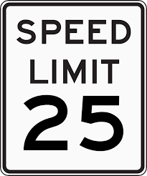
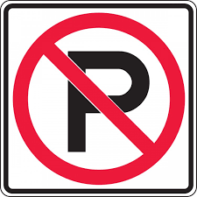
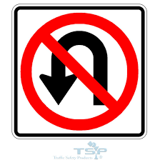
Driving Environments
Session 3
24. The posted ramp speeds are safe for all vehicles, including vans.
False
What does a white sign with this shape mean?

Slide 29
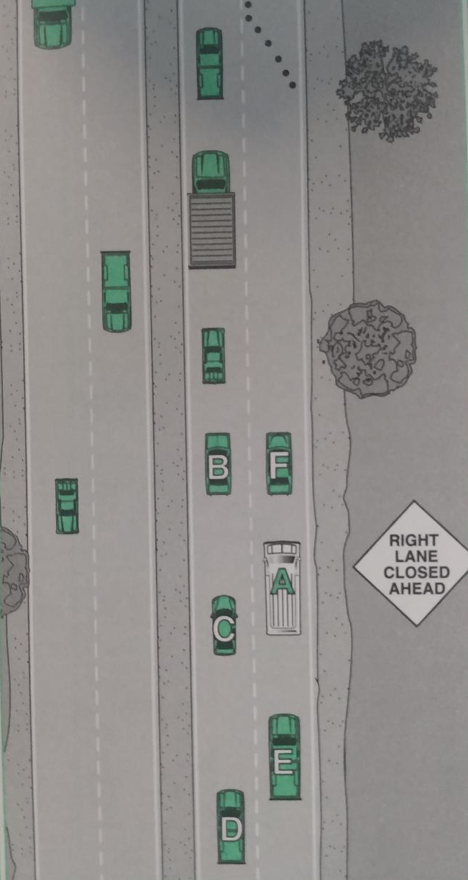
Driving Environments
Session 3
25. In this case “A”’s scanning picks up a “Right Lane Closed Ahead” sign. How far ahead should “A” be scanning in a situation such as this?
Please talk through this situation and describe ho you would handle it safely.

Slide 30
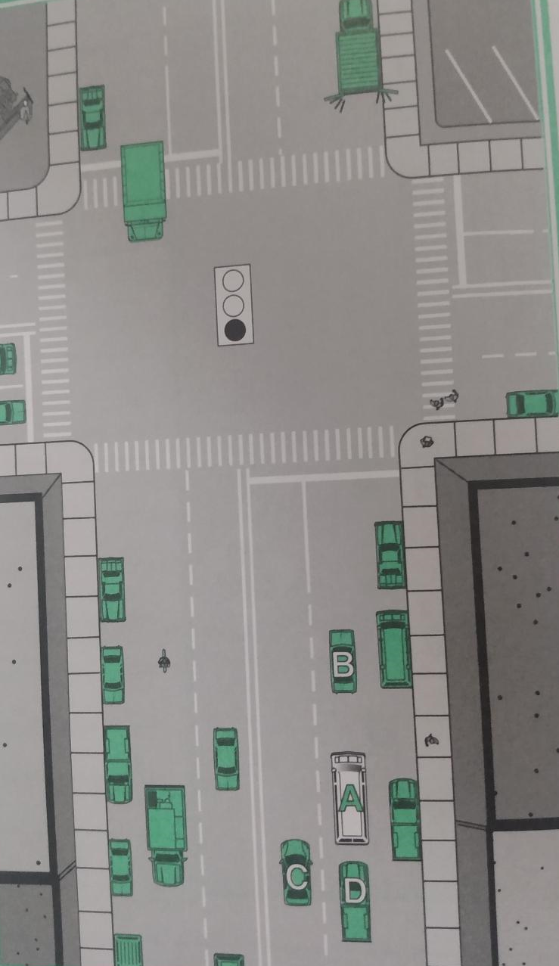
Driving Environments
Session 3
26. In this situation , “A” is approaching an intersection. Assume that the traffic light is green.
What advice would you give the driver of “A” is she intends to turn right at the intersection?
What advice would you give the driver of “A” if she intends to proceed through the intersection?
27. How would you handle a jaywalker waiting to cross the road at midblock?

Slide 31
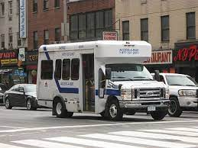
Driving Environments
Session 3
28. When stopping behind another vehicle, what safety considerations should you keep in mind?
29. What should you do if stop within a crosswalk? Why?

Slide 32




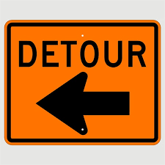
Driving Environments
Session 3
What do orange rectangular and diamond shape signs mean?

Slide 33
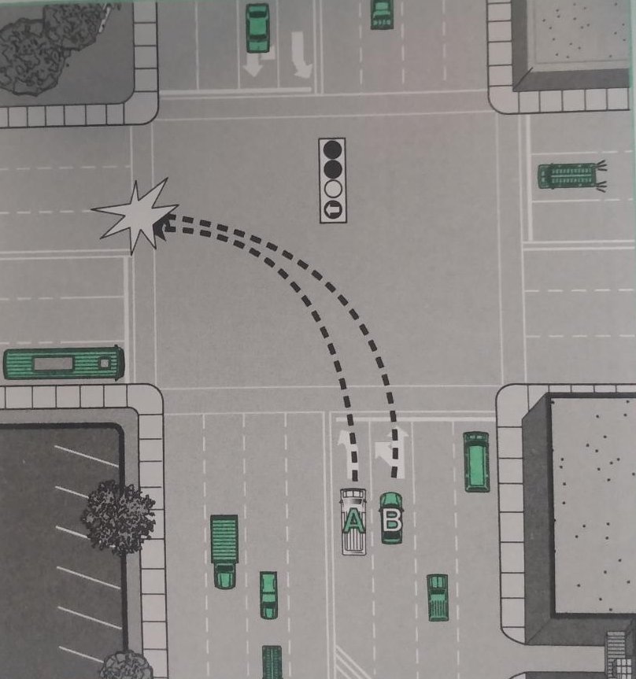
Driving Environments
Session 3
30. In this situation, vehicle “B” ran into the van “A” as they both turned left. What, if anything, could “A” have done to avoid this situation?

Slide 34
Special Considerations (Part One)
Session 4
Video
Page 24 in response book
Notes:
In this session we’ll continue to apply the principles of SCC and see how they can apply to specific driving situations, including when driving on rural roads, when visibility is poor and when encountering bicyclists and emergency vehicles.

Slide 35
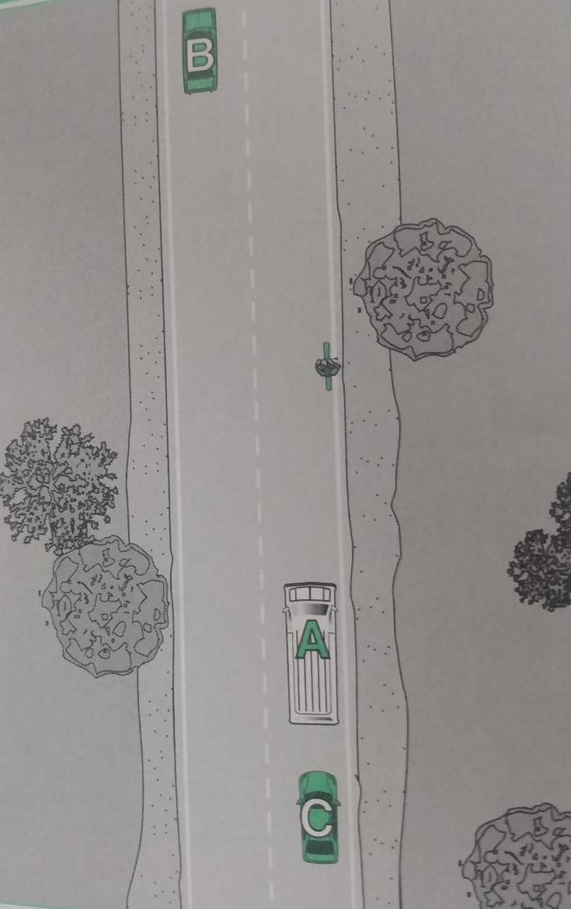
Special Considerations (Part One)
Session 4
31. In this situation, van “A” is approaching a bicyclist on the right side of the road. Describe how “A” should proceed.
What should you do once you know you are being tailgated?
How would you proceed if you were driving vehicle “B”?
How would you proceed if you were driving vehicle “C”?

Slide 36
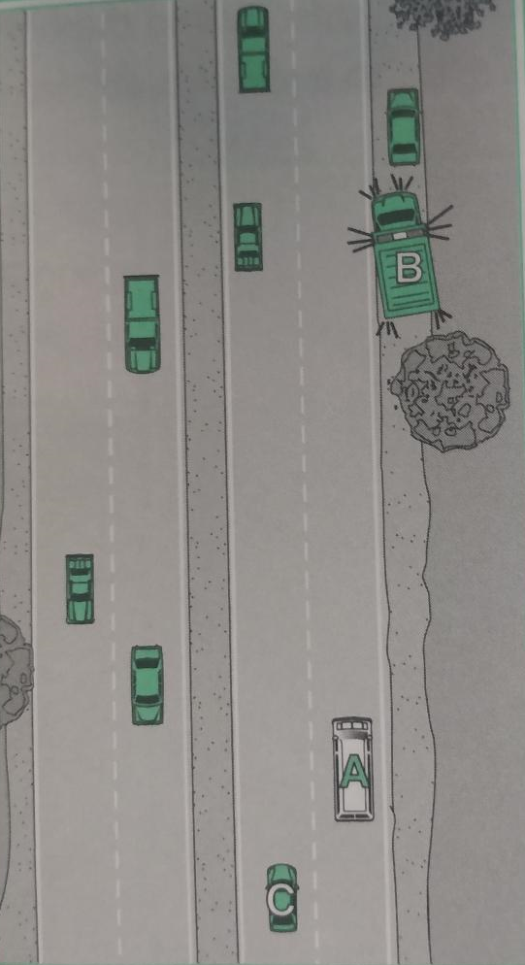
Special Considerations (Part One)
Session 4
32. “A” is approaching an ambulance with its emergency lights on. How should “A” proceed?

Slide 37


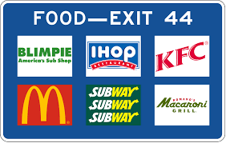
Special Considerations (Part One)
Session 4
What does a blue rectangular sign shape indicate?

Slide 38
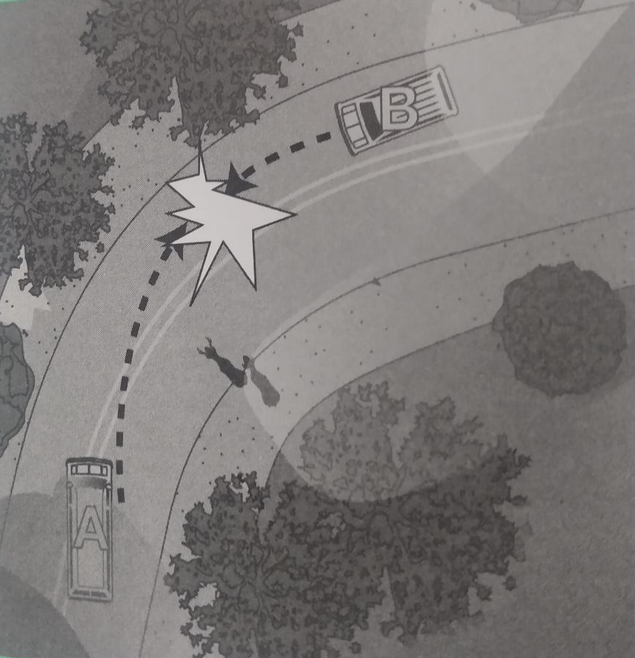
Special Considerations (Part One)
Session 4
33. In this situation, “A” was traveling at the speed limit just after sunrise, so the light was dim and there was a bit of fog in the air. As “A” entered a curve, two deer started out into the road. When “A” moved to the left to avoid the deer, “A” side swiped the oncoming vehicle “B”
What could “A” have done to avoid this collision?

Slide 39
Special Considerations (Part 2)
Session 5
Video
Page 27 in your response book
Notes:
In this session we’ll continue to see how the principles of SCC can help you drive your van safely and collision free.

Slide 40
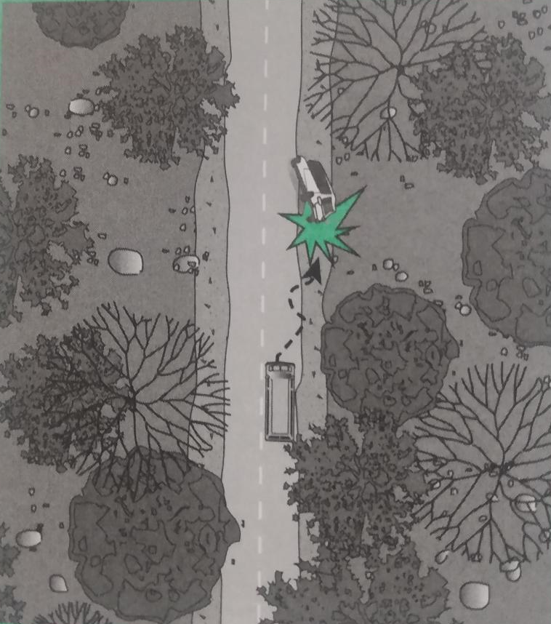
Special Considerations (Part Two)
Session 5
34. “I was traveling on a two-lane road when my phone slipped from my lap. As I reached to catch it before it fell, the right-side tires of the van slipped off the paved road and onto the lower shoulder. When I tried to turn back onto the road, the van shifted to the side and tipped over. Luckily, I was the only one in the van and my safety belt kept me from being seriously hurt, but there was substantial damage to the van.”
What were the contributing factors in this one-vehicle crash?
How would you have handled these circumstances?

Slide 41
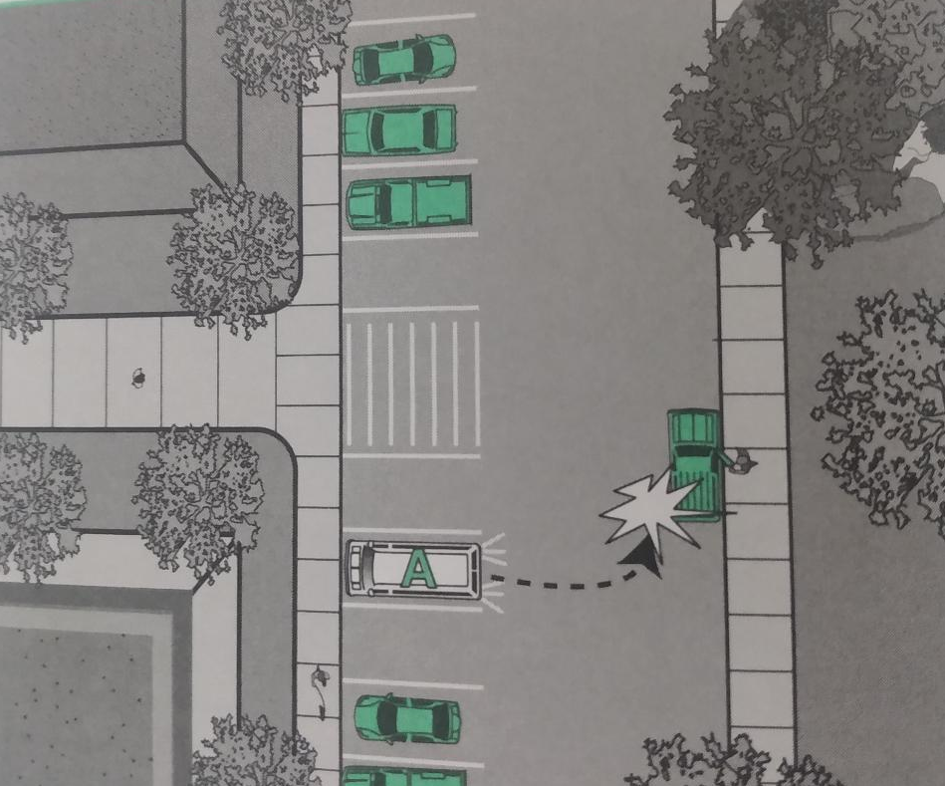
Special Considerations (Part Two)
Session 5
35. “I (A) had finished inspecting my van and checked behind to make sure it was clear because I knew that I would have to back out of the parking spot. I got in, fastened my seat belt and added my destination in my navigation screen. When I backed up, I ran into another vehicle that had pulled up to let somebody out. I swear that it wasn’t there when I checked earlier.”
What were the factors that contributed to this collision?

Slide 42
Special Considerations (Part Two)
Session 5
When you must back
Check that the area around your vehicle is clear of other vehicles, pedestrians and fixed objects.
If possible, choose to back to the driver’s side. Doing so will give you a better view of your path when backing.
Reduce interior noise and lower your window slightly to better hear warnings from others as you back.
Check your mirrors and over your shoulders to confirm that your backing path is clear.
Try to avoid backing whenever possible. What are some strategies you can use to reduce backing?
Parking in such a way or in a location that eliminates the need to back when leaving.
When stopping behind another vehicle, stop so that you can see the other vehicle’s rear tires and a bit of pavement.
When using a spotter, how should you proceed in backing?
Avoid relying on verbal directions.
Agree on hand signals.
Position your spotter where he/she can see the backing path but never within your intended path of travel.
Before backing, make sure your spotter understands where you intend to back.

Slide 43
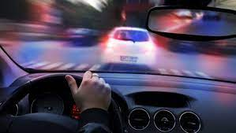
Special Considerations (Part Two)
Session 5
36. For the topics below, list the safety considerations drivers should keep in mind. Be prepared to explain your answers.
Alcohol, Other Drugs and Driving – What is the legal BAC Limit?
Legal BAC limit is .08% for all states except Utah which is .05%
Effects of Alcohol, Other Drugs
Reduced judgement and hazard perception
Reduced reaction time
Tunnel vision
Reduced attentiveness
Reduced peripheral scanning
Reduced tracking skills (steering)
Signs of an impaired driver
Swerving or weaving
Erratic behavior
Driving significantly slower/faster than the speed limit
Illegal turns
Driving without headlights
Driving over designated lane markings
Driving too close to parked cars

Slide 44
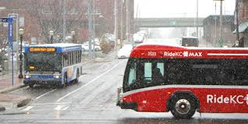
Special Considerations (Part Two)
Session 5
Driving in Adverse Weather
If possible, delay your travel (even a short delay can sometimes make a big difference).
Ability to scan is reduced for you and others.
Low beams often more effective than high beams.
Driving on slippery roadways increases your total stopping distance.
Reduce speed and increase your following distance.
Hydroplaning
Hydroplaning can happen at speeds as low as 30 miles per hour.
Reduce speed and avoid braking suddenly in hydroplaning situations.
Properly inflated tires with adequate tread depth will help you avoid hydroplaning situations.
If hydroplaning, reduce speed by covering the brake (but not braking) to allow the vehicle to regain contact with the road surface.
Avoid using cruise control in hydroplaning conditions.

Slide 45
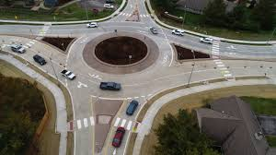
Special Considerations (Part Two)
Session 5
Handling Roundabouts and Traffic Circles Safely
Yield to vehicles already in the traffic circle.
Determine exit point ahead of time.
Stop behind the stop line and crosswalk if waiting to enter.
Once in the traffic circle, scan all around your van for other vehicles. Other drivers might change lanes unpredictable.

Slide 46
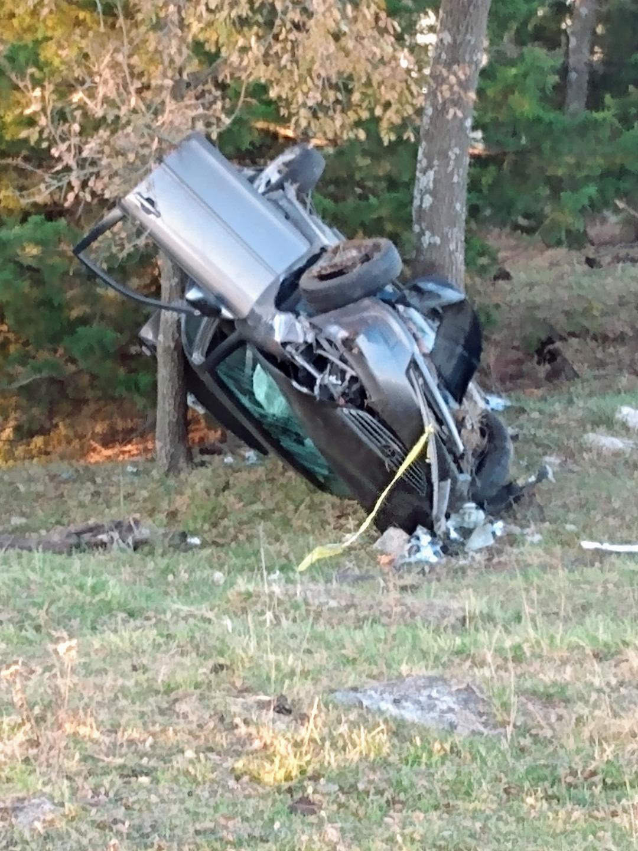
Special Considerations (Part Two)
Session 5
Collison Reporting Procedures
What should you do if you are involved in collision?
What should you do when approaching a collision?
What should you do if you are the first vehicle to arrive at a collision site?

Slide 47

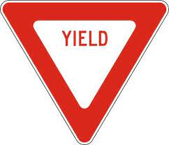
Special Considerations (Part Two)
Session 5
What sign is red and white and has this shape?

Slide 48
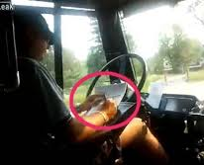
Distracted Driving
Notes:
You face many distractions during the course of your professional day. Some of these distraction are created by you; some by your company; then others by what is happening “outside” of your vehicle.

Slide 49
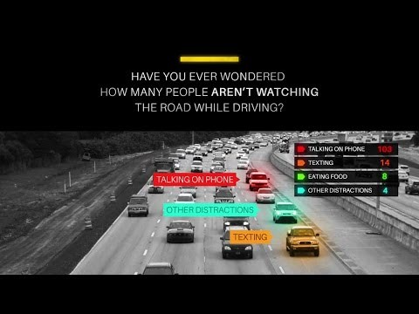
It’s the Other Driver I’m Worried About
Drivers surveyed admitted to the following:
30% ran yellow / red lights
26% slowed but did not come to a complete stop at stop signs
23% drove 10 mph over hwy speed limit
22% drove 10 mph faster than flow of traffic
8% drove when affected by alcohol
80% of drivers admit to blatantly hazardous behavior while driving

Slide 50
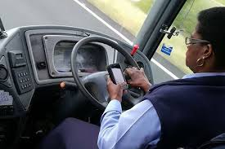
What is Distracted Driving?
Activity that diverts attention from driving
What are some examples of distracted driving?
Talking or Texting On Your Phone
Eating and Drinking
Talking to Passengers
Fiddling with the Stereo or other Entertainment System
Fiddling with the Navigation System
I am driving and talking on the phone at the same time. I am driving distracted but what else am I doing?
Notes:
What Is Distracted Driving?
Distracted driving is any activity that diverts attention from driving, including talking or texting on your phone, eating and drinking, talking to people in your vehicle, fiddling with the stereo, entertainment or navigation system—anything that takes your attention away from the task of safe driving.
Texting is the most alarming distraction. Sending or reading a text takes your eyes off the road for 5 seconds. At 55 mph, that's like driving the length of an entire football field with your eyes closed.
You cannot drive safely unless the task of driving has your full attention. Any non-driving activity you engage in is a potential distraction and increases your risk of crashing.

Slide 51
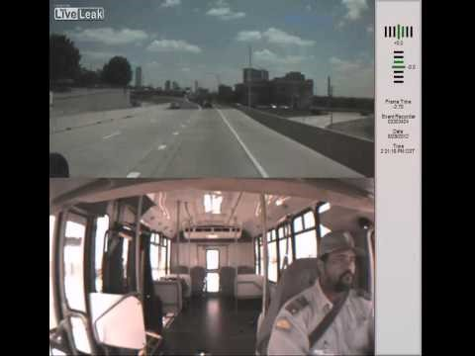
Three Types of Distraction
Visual: taking your eyes off the road.
Manual: taking your hands off the wheel.
Cognitive: taking your mind off driving.
https://www.youtube.com/results?search_query=dart+van+crash
Notes:
Visual distraction is when the driver takes his eyes off the road and does not observe what is immediately in front of him.
Manual distraction involves taking one's hands off the wheel to reach for something… (Radio dial, air conditioner knob, paper on the floor, a child, etc.)
Cognitive or deep-thinking distraction occurs when an individual's focus is not directly on the act of driving and his/her mind wanders to another issue.

Slide 52
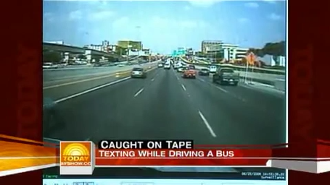
DISTRACTIONS
Let’s see what can happen in 5 seconds
Notes:
Let’s see what can happen in 5 seconds, when the driver takes his eyes off the road. In this incident, the driver was driving at highway speeds, while texting. The cars in front of him were at a complete stop.

Slide 53
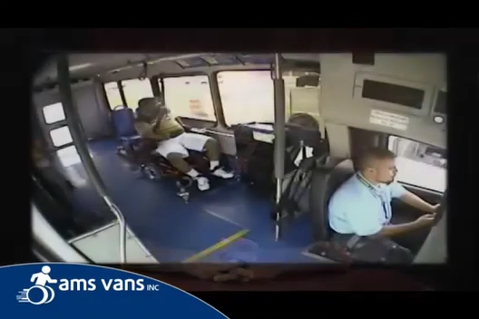
DISTRACTIONS
Here’s what the driver was doing
Notes:
Watch the driver closely. You will notice that his attention is on his phone, not the road ahead. By the time he realizes that the cars in front of him have stopped, it is too late.

Slide 54
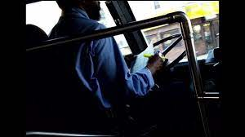
DISTRACTIONS
Company Created Distractions:
Communication radios
  Does your company require you to respond to dispatch while you are driving ?
Cell phones, if your company uses them in place of standard communications equipment.
Fare boxes
Destination signs
Notes:
Has your company created distractions that are part of doing your job? Communication Radios, Company Cell Phones used in place of standard communication equipment, Fareboxes, Destination signs. Does dispatch expect you to respond to them while you are driving? Does your company have a policy regarding how to use this equipment safely. Do you know and follow the policy? Are you only allowed to use this equipment when your vehicle is not moving? Although these are tools of your trade, they do take your attention away from what is going on in and around your vehicle.

Slide 55
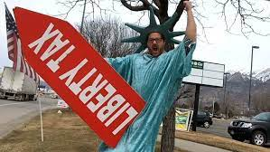
DISTRACTIONS
Distractions Created Outside of Your Vehicle:
Operating at high speed
Calculating speeds and distances
Responding to other drivers and obstacles
Pedestrians
Bicyclists
Looking for addresses
Notes:
If those distractions are not bad enough, you have many things happening “outside” of your vehicle that is causing distractions. You may be operating at high speeds; you are always calculating speeds and distances; you have other drivers, pedestrians, and sometimes bicyclists doing all sorts of things that you need to respond to. When you are driving an unfamiliar route, more than likely you are looking for addresses for picking up or dropping off your passengers. During those times you are more focused on finding the correct location than you are driving.

Slide 56
DISTRACTIONS
Now, take one hand off of the wheel to:
Use the two-way radio, cell phone or other on-board equipment
Adjust the mirror, seat or climate control
Secure items in the vehicle
Eat or drink
You have GREATLY reduced your response time to anything that happens outside of your vehicle
Notes:
If you take one hand off of the wheel for any reason, you GREATLY reduce your response time to anything that may happen outside of your vehicle.

Slide 57
DISTRACTIONS
Drivers who use hand-held devices are four times more likely to get into crashes
Using a cell phone delays a driver’s reactions as much as having a blood alcohol concentration of .08 percent
Notes:
Drivers who use hand-held devices while driving are four times more likely to get into a crash. Using a cell phone while driving can delay a driver’s reaction time equivalent to a .08 blood alcohol content. That is the same reaction time as someone who is legally intoxicated!

Slide 58
DISTRACTIONS
It is a myth…
That we can multi-task
All brains focus in the same way
We can shift our attention quickly, but we cannot pay attention to more than one thing at a time
More than divided, our attention is diverted
Notes:
Study after study has proved that our brains can only focus successfully on one topic at a time. We do a great job shifting from topic to topic, but when we focus on one thing, such as a text message, we cannot pay attention to the traffic that is stopping in front of us.

Slide 59

A Double Dutch | Brain Games - YouTube

Slide 60
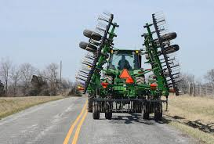





Driving in Rural Areas
Rural areas more dangerous than city areas
Look for hazards such as:
Unmarked field and farm driveways and entrances
Livestock crossings areas
Farm vehicles
Rough road conditions
Roadside stands and gas stations
Soft and unmarked shoulders
Wildlife – Deer and turkey
Notes:
Tips for Driving in rural areas.
Be aware of the speed limit. Many drivers assume that they can drive quickly on rural roads because there is typically little to no traffic. This is not the case.
Use caution when passing. Long, straight stretches of rural roads often allow drivers to pass slower vehicles. If you choose to pass a vehicle, make sure that the section of road on which you intend to pass is marked accordingly.
Watch for hidden driveways. Rural roads are often scattered with residences. When driving on these types of roadways, watch out for driveways. If a rural road is curvy or hilly, driveways can be difficult to see until you are very close to them. This could put you in danger of colliding with another vehicle as it is pulling out onto the road.
tractors, ATVs, and farming combines can often be found on rural roadways. Remember that these vehicles, especially farm equipment, have every right to be on the road. Keep a safe distance between your vehicle and these types of vehicles. The drivers of such vehicles might have limited visibility. If you attempt to pass a large piece of equipment on a rural roadway, make sure that you have plenty of time and space to make the maneuver safely. Above all, be courteous to the drivers of these types of vehicles. These rural roads are their home. They drive on them much more frequently than you do.
n some areas, livestock may be moved across rural roads from time to time. There should be road signs marking these areas and warning drivers to slow down and use caution. If you happen upon a group of cattle or other livestock being moved from one side of a rural road to another, bring your vehicle to a halt and wait patiently for the animals to clear the roadway completely. Do not do anything that may spook the animals like revving your engine or blowing your horn. Stay inside your vehicle for safety.

Slide 61

DRIVER FATIGUE
Notes:
Now let’s explore something else you may face as a driver. Fatigue!

Slide 62

FATIGUE
Causes
Being awake to long
Monotonous tasks
Health factors such as sleep disorders
Effects
Nodding off
Reduced Reaction Time
Making poor decisions
Drifting from your lane
Experiencing “tunnel vision”
Microsleeps
Forgetting the last few miles, you drove
Science of sleep - Fatigue effects on driving 60sec - YouTube
CDC and NIOSH Newsroom Feature - Driver Fatigue on the Job | NIOSH | CDC
Notes:
No amount of desire to drive or stay awake/alert or experience can help workers to escape the effects of fatigue on their driving performance.
Fatigue is broadly described as “a feeling of weariness, tiredness or lack of energy.”¹ Whatever the source – inadequate or poor-quality sleep, long hours of work or driving, physical exertion, shift work, stress, or sleep disorders such as sleep apnea – fatigue affects the ability to drive safely. Employers and workers share the responsibility for managing fatigue and preventing fatigue-related motor vehicle crashes.
NIOSH conducts research and makes recommendations to help employers and workers prevent motor vehicle crashes caused by fatigued driving. Longer daily commutes, nonstandard shift work, less sleep, and lack of employer driving safety policies were associated with one or more risky driving-related outcomes such as drowsy driving, falling asleep, or experience a near miss crash event while driving.² Maintaining good sleep habits is important to your health and safety, on and off the job.
The bottom line:
No amount of experience, motivation, or professionalism can overcome your body’s biological need to sleep. Employers and workers can take steps to prevent the chain of events that could lead to a fatigue-related crash. Employers, learn more about starting a fatigue risk management system.

Slide 63
FATIGUE
According to a Sleep in America poll:
1% or as many as 1.9 million drivers have had a car crash or a near miss due to drowsiness in the past year
54% or 105 million drivers have driven while drowsy at least once in the past year
28% or 54 million drivers do so at least once per month
Notes:
Let me throw a few statistics at you. 1.9 million drivers have had a car crash or near miss due to drowsiness in the past year. 54% of drivers have driven while drowsy at least once in the past. Does this sound familiar? 28% or drivers drive drowsy at least once per month. Maybe this sounds more familiar.

Slide 64
FATIGUE
A study from the AAA Foundation for Traffic Safety states that drivers who skimp on the seven hours of sleep experts recommend increase their risk of a crash exponentially
Missing one to two hours of sleep doubles a driver’s crash risk
While foregoing two or three hours increases the risk of a crash by 400%

Slide 65

FATIGUE
Notes:
(Play video)

Slide 66

FATIGUE
2020 Drowsy Driving Statistics
Most crashes happen between 12 am and 6 a.m., or in the late-afternoon hours. (NHTSA)
1 in 25 drivers admit to falling asleep behind the wheel. (CDC)
Driving after more than 20 hours without sleep is equivalent of driving with a BAC of 0.08. (NSC)
Accounts annually for about 100,000 crashes, 71,000 injuries and 1,550 fatalities. (AAA Foundation)
24 percent of drivers have admitted driving fatigued at least once in the past 30 days. (AAA Foundation)
Notes:
So how do I keep from becoming fatigued? Do not ignore the warning signs. Do not skip meals, or at least eat smaller meals or healthy snacks throughout the day. Avoid medication that may cause drowsiness. Do not rely on the “alertness trick”, they do not work.

Slide 67
Thank You.
Questions?

